Slide 1






Foundations of
Quantum Computing
(QIS 301)
Dave Biersach
Brookhaven National Laboratory
dbiersach@bnl.gov
Session 11
Differential Equations

Slide 2
Session Goals
How to simulate the trajectory of a circus cannon performer
Implement Euler’s Method for finding numerical solutions to physical laws represented as differential equations
Obtain Euler’s Method from Fermat's definition of the derivative
Model the radioactive decay of Fluorine-18 and Carbon-14
Appreciate the importance of stability in numerical solutions
Use Euler’s Method to model the simple harmonic motion of a single (unforced, undamped) pendulum
Use the Euler-Cromer method to eliminate artificial energy gain in the long-term modeling of a system

Slide 3
Session Goals
Estimate numerical solutions to ordinary differential equations (ODEs) using Runge-Kutta Methods
Model coupled pendulums to simulate a Harmonograph and learn about Halo Orbits
Use the numerical ODE estimator built into SciPy
Model a damped oscillator to appreciate the impact of critical damping
Build the S-I-R compartment model in epidemiology
Solve coupled non-linear ODEs to model predator-prey dynamics

Slide 4
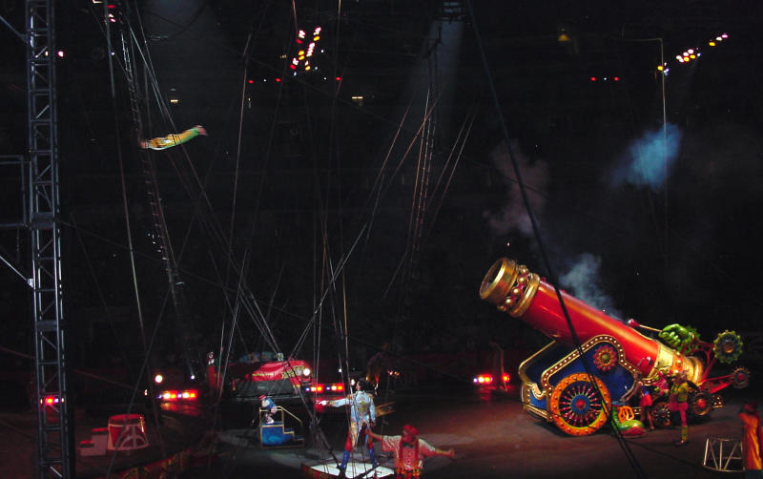
Projectile Motion

Slide 5
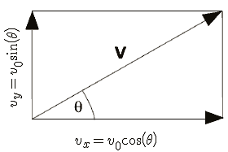
Projectile Motion
$$x=v_{0}∗t∗\cos\left(θ\right)$$
$$y=v_{0}∗t∗\sin\left(θ\right)−\frac{1}{2}gt^{2}$$
$θ= \frac{π}{4}$
$$t= \frac{x}{v_{0}∗\cos\left(θ\right)}$$
Given Range = 400m, what does v₀ need to be?
$$y=\tan\left(θ\right)∗x−\frac{g}{2∗v_{0}^{2}∗\cos^{2}\left(θ\right)}∗x^{2}$$
$$v_{0}=\sqrt{\frac{Range ∗g}{\sin{2θ}}}$$
$$Range= \frac{4h}{tan⁡(θ)}$$
This is the equation of motion that allows us to plot y as x increases from launch point to trampoline
$$h= \frac{v_{0}^{2}\sin^{2}(θ)}{2g}$$

Slide 6
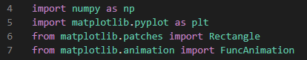
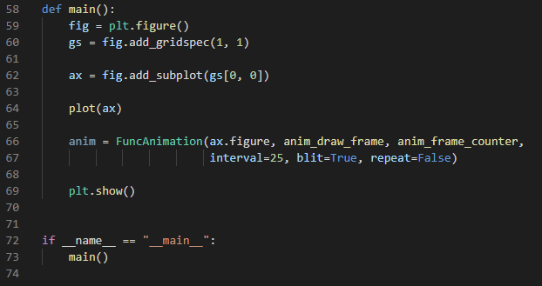
Open projectile_motion.py
①
②
③
④
⑤

Slide 7
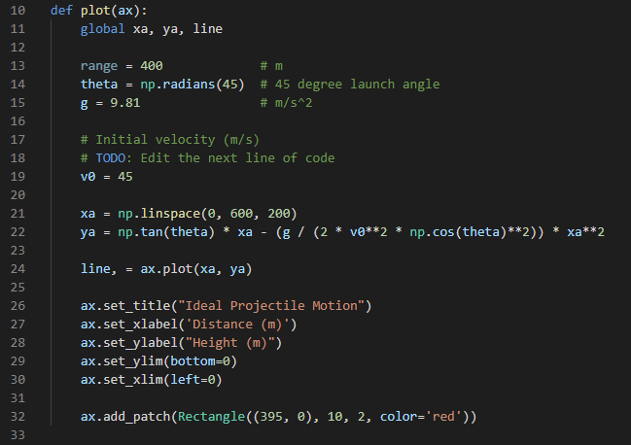
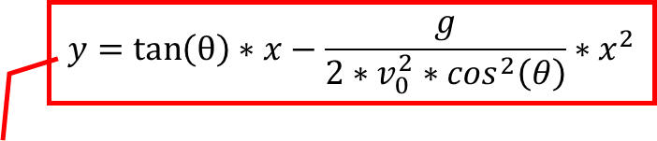
View projectile_motion.py
①
②
$$y=\tan\left(θ\right)∗x−\frac{g}{2∗v_{0}^{2}∗\cos^{2}\left(θ\right)}∗x^{2}$$
③
④
The trampoline is
10m long x 2 m high

Slide 8
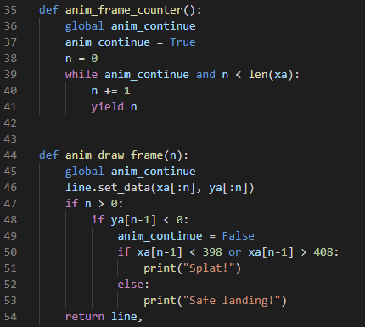
View projectile_motion.py
①
②
③
The frame number n is the index number in the xa array (the 200 x-coordinates of the flying performer)
④
⑤
⑥
⑦

Slide 9
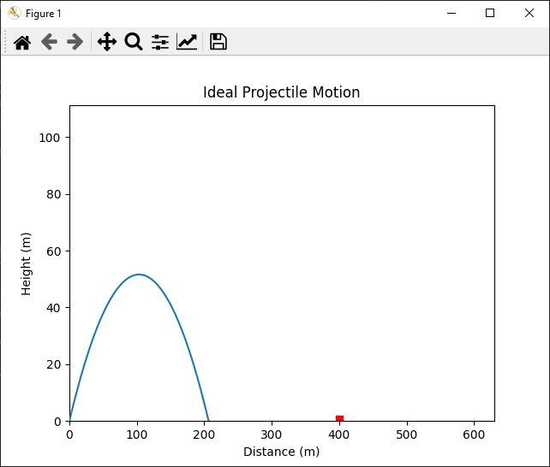
Run projectile_motion.py
The trampoline is 400m from the cannon

Slide 10
Edit projectile_motion.py
Fix this initial velocity $v_{0}$

Slide 11
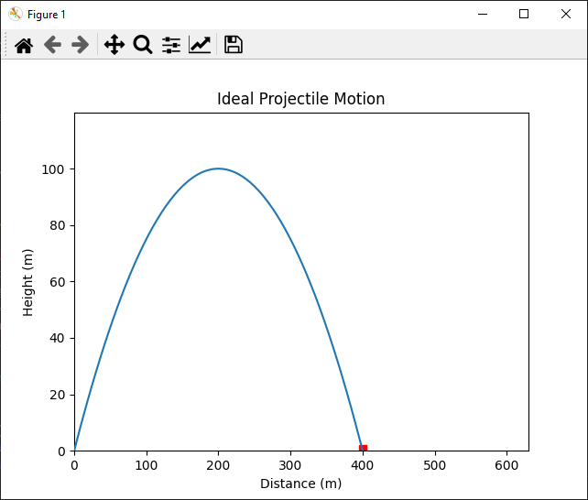
Run projectile_motion.py

Slide 12
Modelling Nuclear Decay
$N\left(t\right)≡$ number of nuclei at time t
$τ≡$ mean lifetime (half life)
$$\frac{dN}{dt}=−\frac{N(t)}{τ}$$
Fermat's Difference Quotient
$$\frac{dN}{dt}=\frac{N\left(t+Δt\right)−N(t)}{Δt}$$
$$−\frac{N(t)}{τ}=\frac{N\left(t+Δt\right)−N(t)}{Δt}$$
$$N\left(t+Δt\right)=N\left(t\right)−\frac{N(t)}{τ}Δt$$
This is Euler’s Method

Slide 13
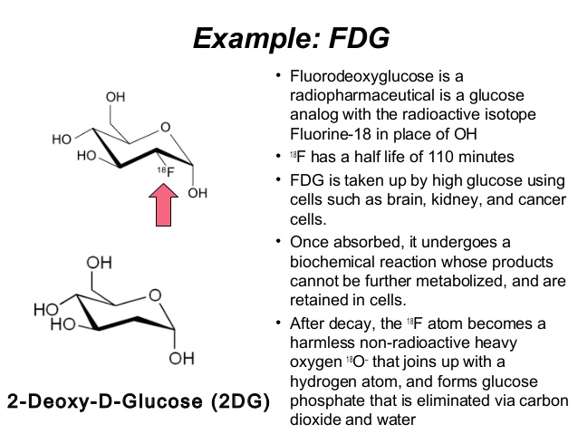
Fluorine-18

Slide 14
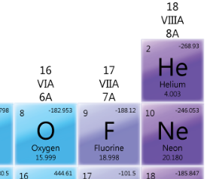
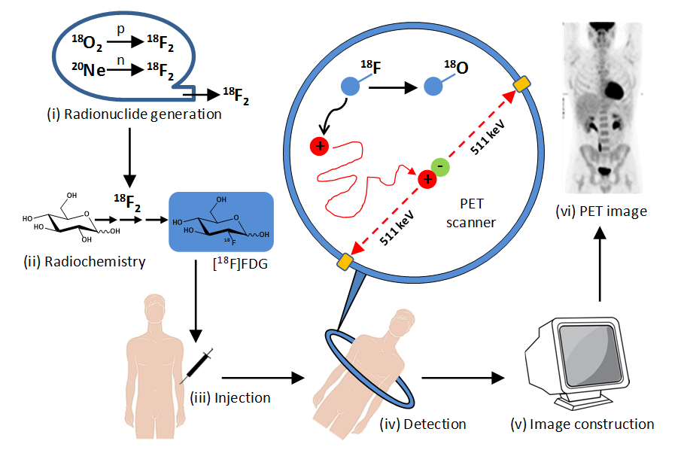
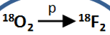

Fluorine-18
At least 5% of the injected Flourine-18 must still be present to be detected

Slide 15
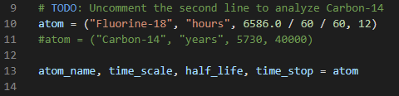
Open nuclear_decay.py
①
②
Unpacking in Python
https://realpython.com/lessons/tuple-assignment-packing-unpacking
https://stackabuse.com/unpacking-in-python-beyond-parallel-assignment

Slide 16
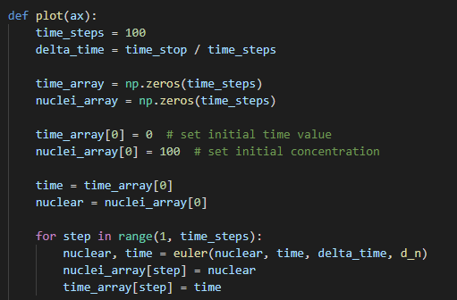
Open nuclear_decay.py
①
②
③
④
⑤
⑦
⑥
⑧

Slide 17
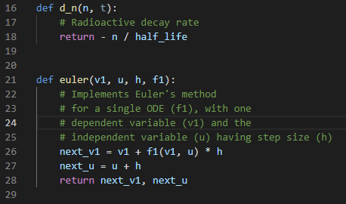
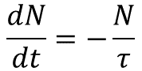
Open nuclear_decay.py
③
④
$$\frac{dN}{dt}=−\frac{N}{τ}$$
①
②
⑤
⑥

Slide 18
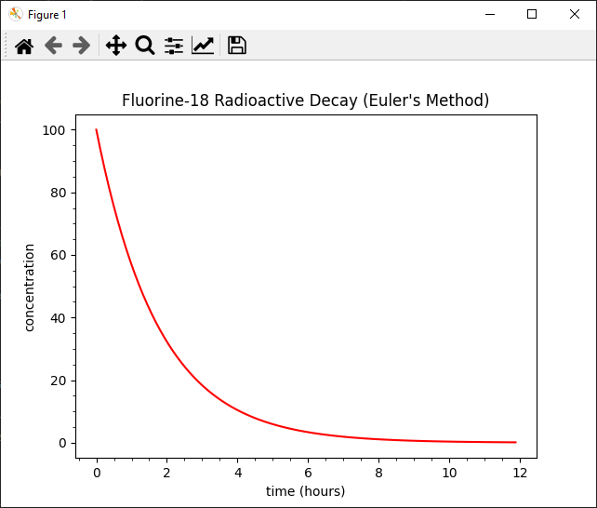
Run nuclear_delay.py
What two key concepts does this graph indicate?
After 12 hours the ingested Fluorine-18 has decayed enough to not be a lingering threat
Medical staff must get patients into the PET scan within 5 hours after taking Fluorine-18
At least 5% of the injected Flourine-18 must still be present to be detected

Slide 19

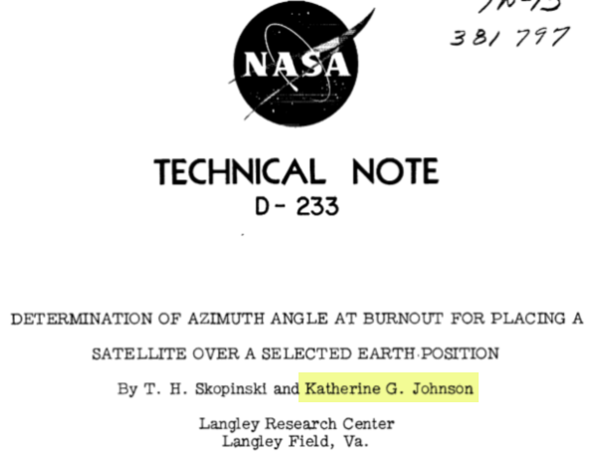
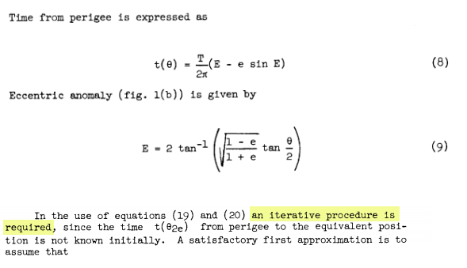
Hidden Figures, Fox 2000 Pictures, 2016
Euler’s Method

Slide 20
Modelling Carbon-14 Decay
Radio carbon dating uses $C^{14}$ isotopes to date items
During their lifetime, organisms absorb a certain amount of Carbon-14 that naturally exists in their environment
When an organism dies, it stops ingesting new Carbon-14 atoms, and the amount already present in the tissues begins to undergo radioactive decay
It is known that $C^{14}$ has a half-life of 5,730 years and at least 0.1% of the original amount of $C^{14}$must be present to be detectable
Given the half-life, how far back in time can scientists can use radio carbon dating to determine the age of an item?

Slide 21
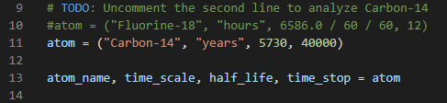
Edit nuclear_decay.py

Slide 22
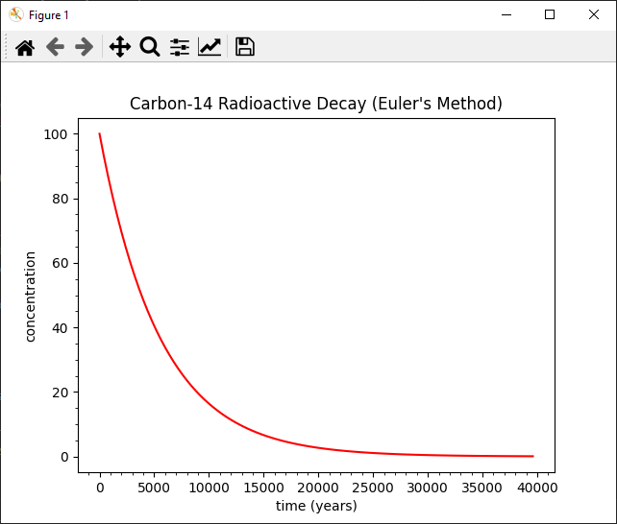
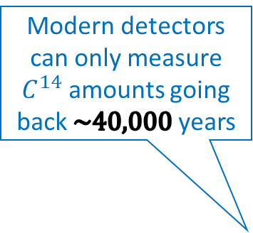
Run nuclear_decay.py
Modern detectors can only measure $C^{14}$ amounts going back $\sim 40,000$ years

Slide 23
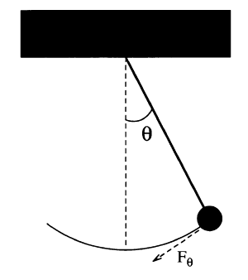
Modelling a Simple Pendulum
Gravity is a restoring force
$$F_{θ}=−mg\sin{θ}$$
$$ml\frac{d^{2}θ}{dt^{2}}=−mg\sin{θ}$$
$$l$$
$$\sin{θ}≈θ \left(for θ<{22}^{°}\right)$$
$$\frac{d^{2}θ}{dt^{2}}=−\frac{g}{l}θ$$
But Euler’s Method works only on first order ODEs! ☹
$$s=lθ$$
$$F=ma$$
$$\frac{d^{2}s}{dt^{2}}=l\frac{d^{2}θ}{dt^{2}}$$
$$F=m\frac{d^{2}s}{dt^{2}}$$
$$\frac{dω}{dt}=−\frac{g}{l}θ$$
We can break the 2nd order ODE into two linked first order ODEs and use Euler’s method on each
$$F_{θ}=ml\frac{d^{2}θ}{dt^{2}}$$
$$\frac{dθ}{dt}=ω$$

Slide 24
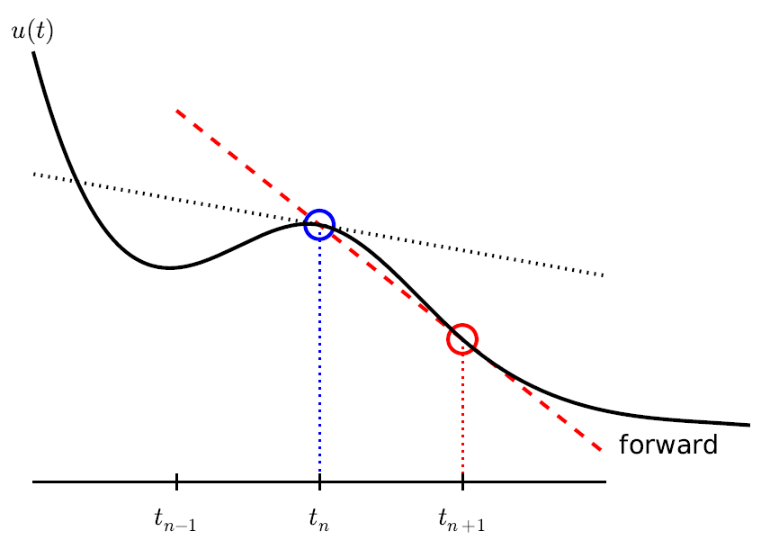
Modelling a Simple Pendulum
$$\frac{dω}{dt}=−\frac{g}{l}θ$$
$$ω_{i+1}=ω_{i}−\frac{g}{l}θ_{i}Δt$$
$$l$$
$$\frac{dθ}{dt}=ω$$
$$θ_{i+1}=θ_{i}+ω_{i}Δt$$
This is Euler’s Method

Slide 25
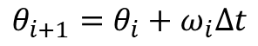
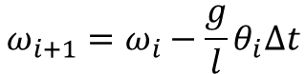
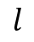
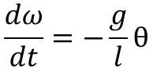
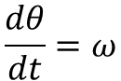
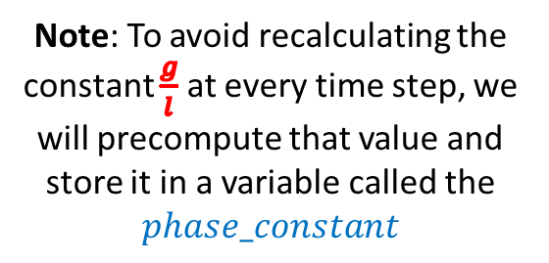
Modelling a Simple Pendulum
$$\frac{dω}{dt}=−\frac{g}{l}θ$$
$$ω_{i+1}=ω_{i}−\frac{g}{l}θ_{i}Δt$$
$$l$$
$$\frac{dθ}{dt}=ω$$
$$θ_{i+1}=θ_{i}+ω_{i}Δt$$
Note: To avoid recalculating the constant $\frac{g}{l}$ at every time step, we will precompute that value and store it in a variable called the
$$phase_constant$$

Slide 26
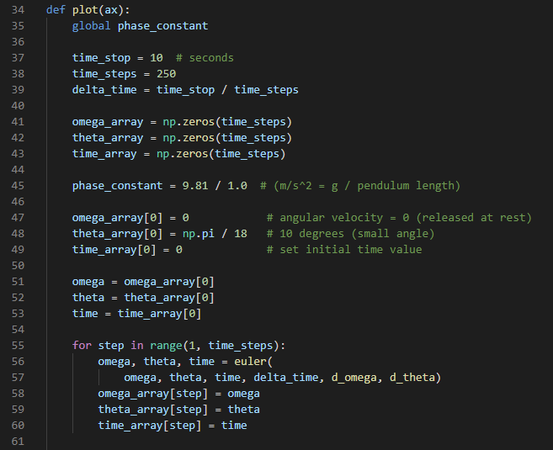
Open pendulum.py
①
②
③
④
⑤
⑥
⑦
⑧

Slide 27
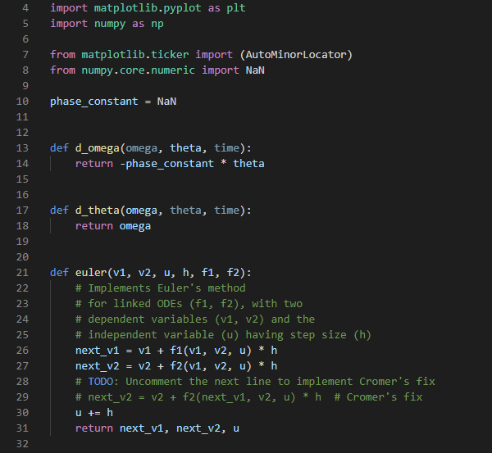
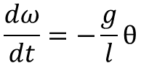
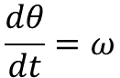
View pendulum.py
①
②
④
$$\frac{dω}{dt}=−\frac{g}{l}θ$$
⑤
$$\frac{dθ}{dt}=ω$$
③
⑥
⑦

Slide 28
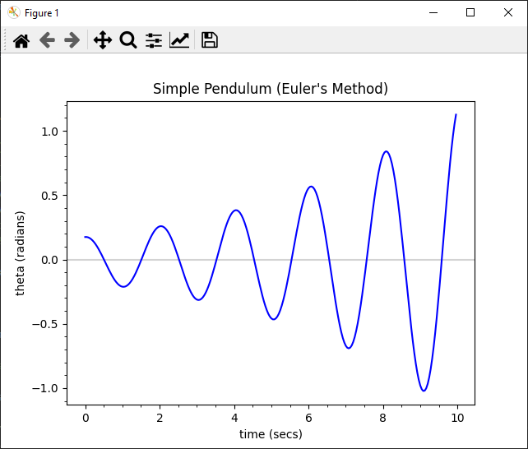
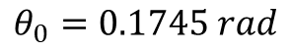
Run pendulum.py
Pendulum angular displacement from centerline
$$θ_{0}=0.1745 rad$$
This is not good… The model predicts the pendulum will begin to swing wildly, which should not naturally happen!

Slide 29
Instability of Euler Method For Highly Oscillatory Modes
kinetic
potential
Increasing timeSteps 10x does not prevent the displacement from growing after each oscillation
This simple Euler method worked fine for modelling radioactive decay – but it is unstable for harmonic motion
The energy in the system is artificially growing over time without any bounds
$$E=\frac{1}{2}ml^{2}ω^{2}+mgl(1−\cos{θ})$$
$$\left(θ<{22}^{°},\cos{θ}≈1−\frac{θ^{2}}{2}\right)$$
$$E=\frac{1}{2}ml^{2}\left(ω^{2}+\frac{g}{l}θ^{2}\right)$$
$$E_{i+1}=E_{i}+\frac{1}{2}mgl^{2}\left(ω_{i}^{2}+\frac{g}{l}θ_{i}^{2}\right){\left(Δt\right)}^{2}$$
Due to the squaring of both variables, the next energy state will always be larger than the previous energy state

Slide 30
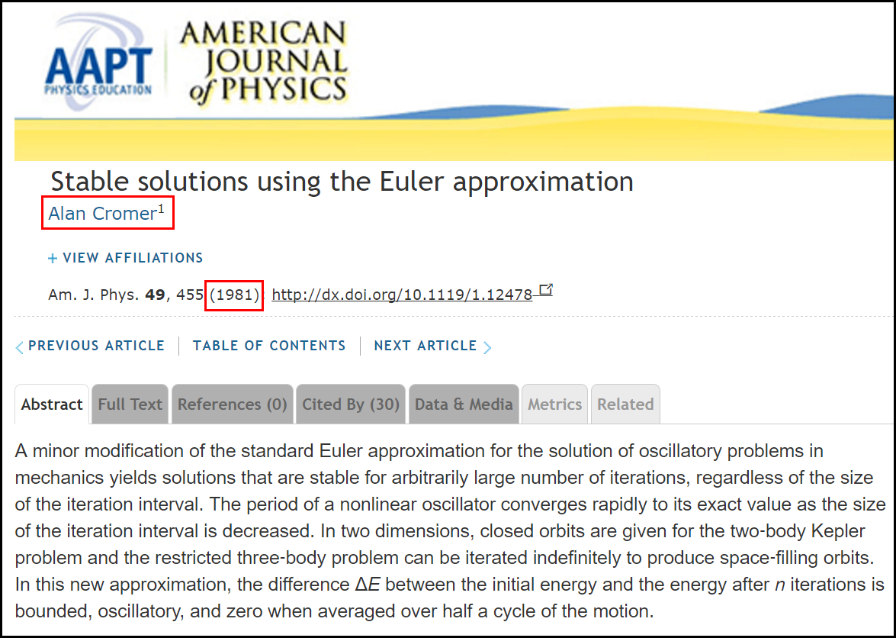
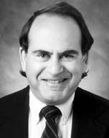
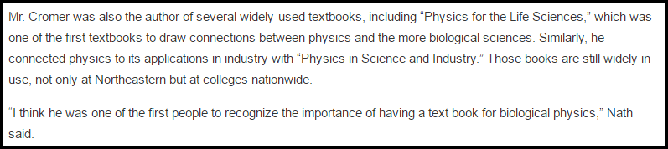
The Euler-Cromer Method

Slide 31
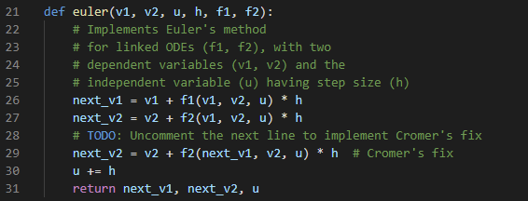
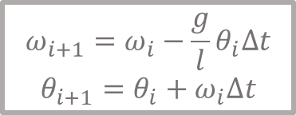
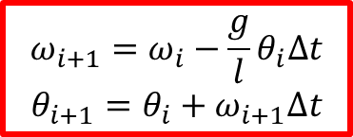
Edit pendulum.py
Euler
Euler-Cromer
$$ω_{i+1}=ω_{i}−\frac{g}{l}θ_{i}Δt$$
$$θ_{i+1}=θ_{i}+ω_{i}Δt$$
$$ω_{i+1}=ω_{i}−\frac{g}{l}θ_{i}Δt$$
$$θ_{i+1}=θ_{i}+ω_{i+1}Δt$$

Slide 32
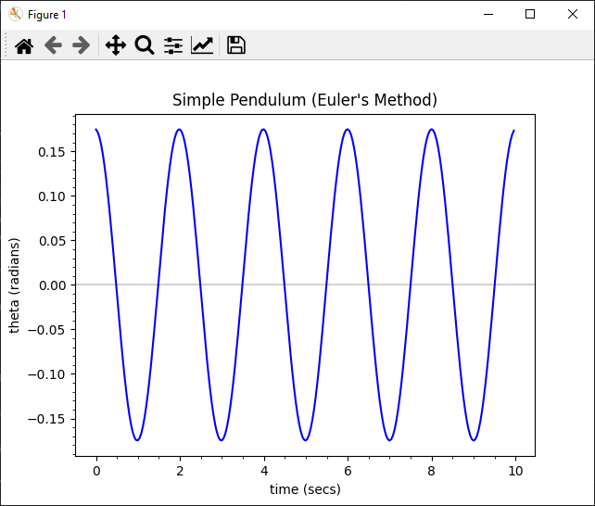
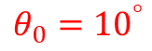
Run pendulum.py
$$θ_{0}={10}^{°}$$
The model is now stable as iteration of the numerical method does not add false energy to the system.

Slide 33
Runge-Kutta Methods
Around 1900, two German mathematicians, Carl Runge and Wilhelm Kutta, wanted to improve the accuracy of Euler's method
Following the same motivation underlying Simpson's Rule for numerical integration, they developed a method of interpolating a curve between the endpoints of a sampled interval
Using a weighted combination of tangent lines sampled throughout an interval, a more accurate derivative can be calculated than via the single tangent line used in Euler's Method

Slide 34
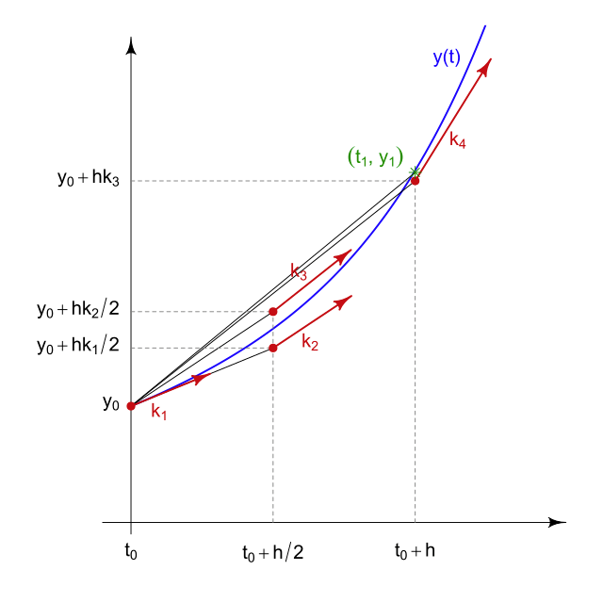
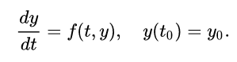
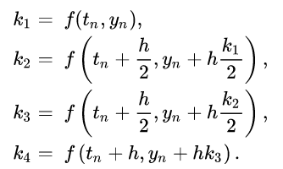
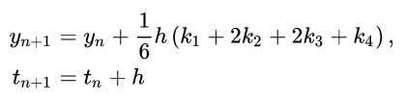
Runge-Kutta Methods

Slide 35
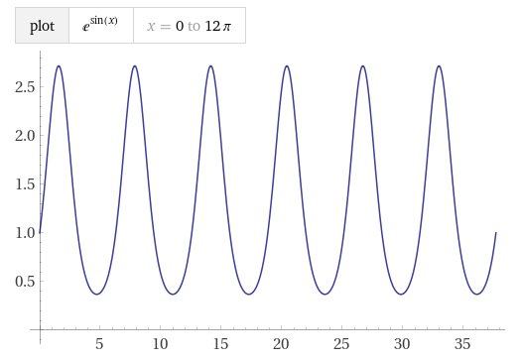








Runge-Kutta Methods
$$\frac{dy}{dx}=y∙\cos{x}$$
$$\ln{y}=\sin{x}+c$$
$$y=ce^{\sin{x}}$$
$$\left(\frac{1}{y}\right)\frac{dy}{dx}=\cos{x}$$
Initial Value
$$y\left(0\right)=1→c=1$$
$$\int{\left\{\left(\frac{1}{y}\right)\frac{dy}{dx}\right\}}ⅆx=\int{\left(\cos{x}\right)ⅆx}$$
$$\int{\frac{1}{y}ⅆy}=\int{\left(\cos{x}\right)ⅆx}$$
$$\ln{y}+c=\sin{x}+c$$

Slide 36

Open ode_rk4.py
①
②
③
④
⑤
⑥
⑧
⑦

Slide 37


Open ode_rk4.py
$$\frac{dy}{dx}=y∙\cos{x}$$
①
②
③
④
⑤
⑥
⑦

Slide 38

Run ode_rk4.py
Euler's Method continues to lose accuracy each iteration

Slide 39



Open pendulum_rk4.py
①
$$\frac{dω}{dt}=−\frac{g}{l}θ$$
②
$$\frac{dθ}{dt}=ω$$
③
④
⑤
⑥

Slide 40

Run pendulum_rk4.py
RK4 is both stable and accurate even for highly oscillatory systems

Slide 41

Coupled Harmonograph

Slide 42


Coupled Harmonograph
Each pendulum controls the X or Y displacement

Slide 43

Open harmonography.py
①
②
③
④
⑤
⑥
⑦

Slide 44


Run harmonography.py
$$l_{1}≠l_{2}$$
$$θ_{1i}=θ_{2i}$$
$$ω_{1i}=ω_{2i}$$

Slide 45


Edit harmonography.py
Can you reproduce this curve?
$$l_{1}=l_{2}$$
$$θ_{1i}=θ_{2i}$$
$$ω_{1i}<ω_{2i}$$

Slide 46


Lissajous Figures

Slide 47

Lissajous Orbits

Slide 48

Lissajous Orbits
Lagrange Point
Lagrange Point

Slide 49

Lissajous Orbits
A Halo Orbit

Slide 50


Slide 51
Solve ODEs with SciPy
The Runge-Kutta Method is useful, but it is tedious to reimplement that same code repeatedly in every program that must simulate a model containing differential equations
Fortunately, the Python package SciPy contains several ready-to-use numerical methods to estimate the solution to a variety of differential equations
Ordinary and Partial Differential Equations (ODE/PDE)
Linear and Non-Linear Equations
Initial Value Problem (IVP) and Boundary Value Problems (BVP)
Both Individual and Systems of Linked Equations

Slide 52


Open pendulum_scipy.py
③
④
$$\frac{d^{2}θ}{dt^{2}}=−\frac{g}{l}\sin{θ}$$
⑤
⑥
We are no longer restricted to the small angle approximation
①
②
⑦
⑧

Slide 53


Run pendulum_scipy.py
$$θ_{0}={75}^{°}$$
What is physics story behind these circles?
SciPy uses RK45 which is Fehlberg's enhancement to classic Runge-Kutta

Slide 54
Damped Harmonic Oscillator
In real oscillators, friction, or damping, slows the motion of the system. Due to frictional force, the velocity decreases in proportion to the acting frictional force
While in a simple undriven harmonic oscillator the only force acting on the mass is the restoring force, in a damped harmonic oscillator there is in addition a frictional force which is always in a direction to oppose the motion
We always strive to develop mathematical models that are as realistic as possible – friction is hard to ignore

Slide 55





Damped Harmonic Oscillator
$$\frac{d^{2}θ}{dt^{2}}=−\frac{g}{l}θ$$
We can introduce a new resistive force term into the equation of motion for a pendulum
$$\frac{d^{2}θ}{dt^{2}}=−q\frac{dθ}{dt}−\frac{g}{l}θ$$
$q$= damping_constant
$$\frac{dω}{dt}=−q\frac{dθ}{dt}−\frac{g}{l}θ$$
$$\frac{dθ}{dt}=ω$$

Slide 56

Damped Harmonic Oscillator
Underdamped – The system swings back and forth over its equilibrium point, but ultimately comes to rest
$$q=1$$
Overdamped – The system never oscillates, but it takes a while for it to return to its equilibrium point
$$q=\frac{{\left(phase_constant\right)}^{2}}{2}$$
Critically damped – The system never oscillates and returns to its equilibrium point in the least amount of time
$$q=\frac{{\left(phase_constant\right)}^{2}}{4}$$

Slide 57


Open pendulum_damped.py
①
②
③
④
⑤
$$\frac{d^{2}θ}{dt^{2}}=−q\frac{dθ}{dt}−\frac{g}{l}θ$$

Slide 58

Open pendulum_damped.py
①
②
③
④
⑤

Slide 59

Run pendulum_damped.py
$$θ_{0}={10}^{°}$$
In what applications would you want a system to be critically damped?

Slide 60





Predator-Prey Modelling
https://en.wikipedia.org/wiki/Lotka-Volterra Equations
Visualize the Lotka-Volterra differential equations
with these characteristics & initial conditions:
$$α=2, β=1.1, γ=1.0, δ=0.9$$
$$x\left(0\right)=1, y\left(0\right)=0.5$$
In this model, at any time$t$ :
$x\left(t\right)$ represents the prey population
$y\left(t\right)$ represents predator population
$α=$ Prey Birth Rate
$β=$ Prey Death Rate
$γ=$ Pred Death Rate
$δ=$ Pred Birth Rate
The solution to their system of coupled non-linear first order differential equations can be numerically estimated using the scicpy solve_ivp function

Slide 61

Open predator_prey.py
①
②
③
④
⑤
⑥
⑦
⑧

Slide 62



Edit predator_prey.py
①
②
③
④
⑤
⑥
⑦
In this model, at any time$t$ :
$x\left(t\right)$ represents the prey population
$y\left(t\right)$ represents predator population
$$α=2, β=1.1, γ=1.0, δ=0.9$$
$$x\left(0\right)=1, y\left(0\right)=0.5$$

Slide 63


Edit predator_prey.py
$α=$ Prey Birth Rate
$β=$ Prey Death Rate
$γ=$ Pred Birth Rate
$δ=$ Pred Death Rate
⑥
⑦
In this model, at any time$t$ :
$x\left(t\right)$ represents the prey population
$y\left(t\right)$ represents predator population
$$α=2, β=1.1, γ=1.0, δ=0.9$$
$$x\left(0\right)=1, y\left(0\right)=0.5$$

Slide 64

Run predator_prey.py
What story is this graph telling?

Slide 65



Modelling Infectious Diseases
Based upon the work of Hudson and Ross, the Kermack-McKendrick (1933) S-I-R equations model the spread of infectious diseases throughout a population
$$\frac{ⅆS}{ⅆt}=−βSI$$
$$\frac{ⅆI}{ⅆt}=βSI−δI$$
$$\frac{ⅆR}{ⅆt}=δI$$
$S(t)$ = Susceptible population
$I(t)$ = Infected population
$R(t)$ = Recovered population
Hilda Hudson
$β=$ Infection rate factor
$δ=$ Recovery rate factor
As time progresses, the population changes from one compartment to the next: $S→I→R$
Note: the total population in this model does not change
Ronald Ross
We seek the functions $S\left(t\right), I\left(t\right),and R(t)$

Slide 66


Modelling Infectious Diseases
$β=$ Infection rate factor
$δ=$ Recovery rate factor
As people become infected the susceptible population decreases.
More infected people also spread the disease faster.
$$\frac{ⅆS}{ⅆt}=−βSI$$
William Kermack
More susceptible people make it easier for the infection to find a new host.
Susceptible people become infected and infected people become recovered.
$$\frac{ⅆI}{ⅆt}=βSI−δI$$
The number of recovered people increases over time.
$$\frac{ⅆR}{ⅆt}=δI$$
Anderson McKendrick

Slide 67







Open epidemiology_sir.py
$β=$ Infection rate factor
⑦
$δ=$ Recovery rate factor
①
⑧
②
$$\frac{ⅆS}{ⅆt}=−βSI$$
③
④
$$\frac{ⅆI}{ⅆt}=βSI−δI$$
⑤
$$\frac{ⅆR}{ⅆt}=δI$$
⑥

Slide 68

Run epidemiology_sir.py

Slide 69

SIR Model Epidemiology
The infected population will drop more slowly than its rise, hence it takes longer to rid a population of infection than it takes for the initial infection to spread
A small but not insignificant percentage of people will always remain susceptible; hence the need for a long-term vaccination sustainment program becomes evident

Slide 70


Slide 71

Now you know…
How to develop the equations of motion to accurately plot the 2D trajectory of a projectile moving through a uniform gravitational field
Euler’s Method (time step analysis) yields numeric solutions to differential equations
We model 2nd order differentials by representing them as a chain of linked 1st order equations
Euler-Cromer is better when modelling harmonic oscillators
Increasing the number of time steps (decreasing $∆t)$ improves the accuracy of the estimations
However, using more time steps also causes the program to take much longer to produce an answer - scientific computing aims to balance the competing demands between greater accuracy and greater speed

Slide 72
Now you know…
The scipy package has many numerical solvers for systems of differential equations
Even a simple set of linked differential equations can yield highly complex long-term behavior of systems
Most dynamical systems have critical values that are related to its fundamental equilibrium points (consider the damping constant)
The S-I-R epidemiology models have been greatly enhanced by modern research in computational biology
We can estimate solutions to systems of linked non-linear ODEs using the Runge-Kutta Method
The language of all science is Differential Equations – please try to learn about them!

